Slide 1
MRE 492 Robotic Vision
Representing Position and Orientation

Slide 2
Outline
Position and Orientation
Representing Poses in 2D
Representing Poses in 3D
Rotation Matrices
Three-angles
Axis-angles
Unit Quaternions
3D Poses

Slide 3
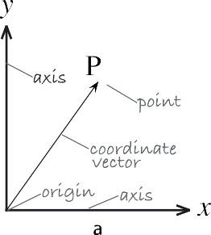

Positions and Orientations
Need for representing positions and orientations in space.
The position of a point is represented by a vector of coordinates.

Slide 4
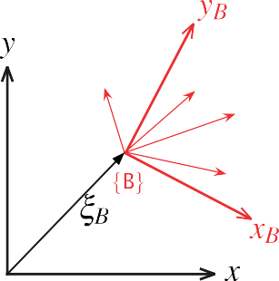
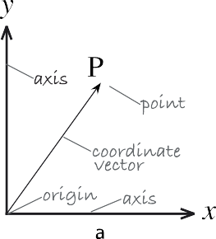



Representing a set of points
Method 1: Represent the position and orientation of each point separately
Method 2: Represent the points in the set’s reference frame and represent the position and orientation of that frame (with ξ_{B} ).

Slide 5
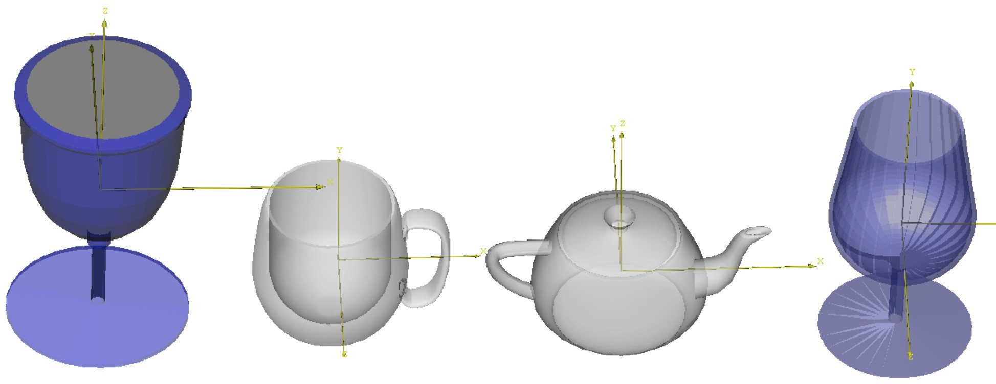
Representing a set of points
Notes:
Each model have a “reference” frame location

Slide 6
Investigating pose in 2D
𝑦_{𝐴}
𝑦_{𝐵}
𝑃
𝑥_{𝐵}
𝐵
𝐴_{𝜉𝐵}
𝐴 𝑥_{𝐴}
Recall that we can think of ^{𝐴}𝜉_{𝐵} as the translation and rotation required in order to make
𝐴 coincide with 𝐵

Slide 7
Investigating pose in 2D
𝑦_{𝐴}
𝑦_{𝐵}
𝑃
𝑥_{𝐵}
𝐵
θ
𝐴_{𝒕𝐵}
𝐴 𝑥_{𝐴}
Recall that we can think of ^{𝐴}𝜉_{𝐵} as the translation and rotation required in order to make
𝐴 coincide with 𝐵
To coincide with 𝐵 , 𝐴 must undergo a translation ^{𝐴}𝒕_{𝐵} and a rotation by an angle 𝜃

Slide 8
Investigating pose in 2D
𝑦_{𝐴}
𝑦_{𝐵}
𝐴_{𝑦}
𝑃
𝐵_{𝑦}
𝐵_{𝑥}
θ
𝑥_{𝐵}
𝐵
^{𝐴𝑡}𝐵y
𝐴_{𝒕𝐵}
𝐴
^{𝐴𝑡}𝐵x
𝐴_{𝑥}
𝑥_{𝐴}
Let ^{𝐴}𝒑 =
^{𝐴}𝑥, ^{𝐴}𝑦 ^{𝑻}, ^{𝐵}𝒑 =
^{𝐵}𝑥, ^{𝐵}𝑦 ^{𝑻} and ^{𝐴}𝒕 =
𝐴_{𝑡}
, ^{𝐴}𝑡
𝑻
𝐵
𝐵x
𝐵y

Slide 9
Investigating pose in 2D
𝑦_{𝐴}
𝑦_{𝐵}
𝐴_{𝑦}
𝑃
𝐵_{𝑦}
𝐵_{𝑥}
θ
𝑥_{𝐵}
𝐵
^{𝐴𝑡}𝐵y
𝐴_{𝒕𝐵}
𝐴
^{𝐴𝑡}𝐵x
𝐴_{𝑥}
𝑥_{𝐴}
Let ^{𝐴}𝒑 =
^{𝐴}𝑥, ^{𝐴}𝑦 ^{𝑻}, ^{𝐵}𝒑 =
^{𝐵}𝑥, ^{𝐵}𝑦 ^{𝑻} and ^{𝐴}𝒕 =
𝐴_{𝑡}
, ^{𝐴}𝑡
𝑻
^{B} x cosθ
𝐵
𝐵x
𝐵y
𝐵_{𝑦}
^{B} y sinθ
θ
𝐵_{𝑥}
θ
From the figure we can see that
^{A} x = ^{A}t + ^{B} x cosθ − ^{B} y sinθ
Bx
^{A} y = ^{A}t + ^{B} x sinθ + ^{B} y cosθ
By
^{B} y sinθ
^{B} x cosθ

Slide 10
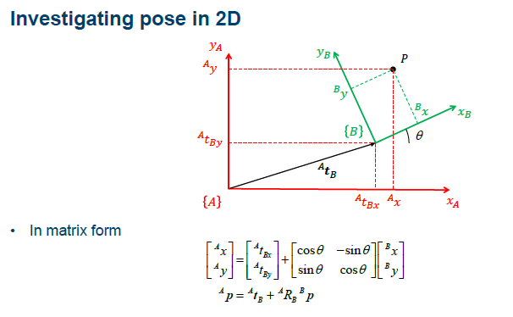
Investigating pose in 2D

Slide 11

Investigating pose in 2D
Can we represent the pose ^{𝐴}𝜉_{𝐵} by the pair
^{𝐴}𝑅_{𝐵}, ^{𝐴}𝒕_{𝐵} ?

Slide 12
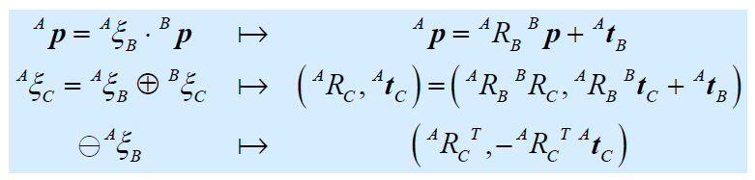
Investigating pose in 2D
Can we represent the pose ^{𝐴}𝜉_{𝐵} by the pair
^{𝐴}𝑅_{𝐵}, ^{𝐴}𝒕_{𝐵} ?
Yes, but there is a better option!
Notes:
Change from non-linear operation to linear

Slide 13
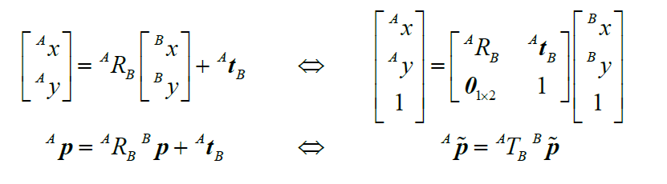
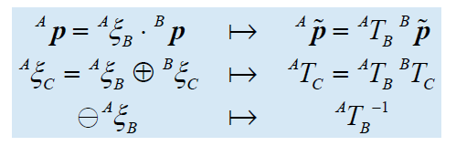
Investigating pose in 2D
Observe the following equivalence
Can we represent the pose ^{𝐴}𝜉_{𝐵} by the matrix ^{𝐴}𝑇_{𝐵}?
Yes, and the algebraic properties are nice!

Slide 14
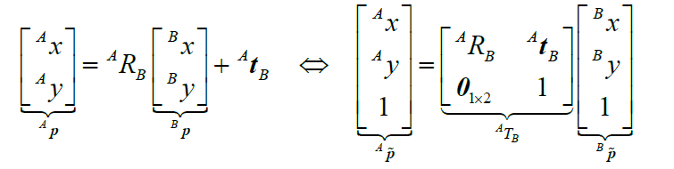
Investigating pose in 2D
But…
We are describing points in the plane with 3 coordinates despite that they only have 2 degrees of freedom…
The non linear transformation ^{𝐵}𝒑 ↦ ^{𝐴}𝒑 then becomes a linear transformation ^{𝐵}𝒑 ↦ ^{𝐴}𝒑
What is going on?

Slide 15
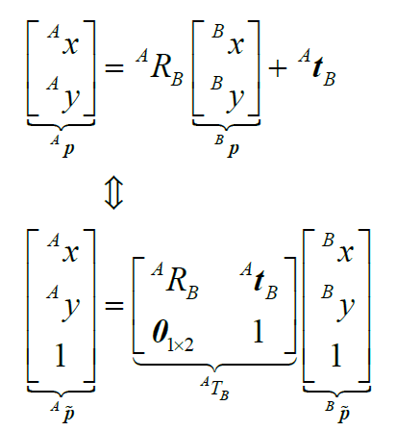
Investigating pose in 2D
We have “discovered” some basic constructions from projective geometry

Slide 16
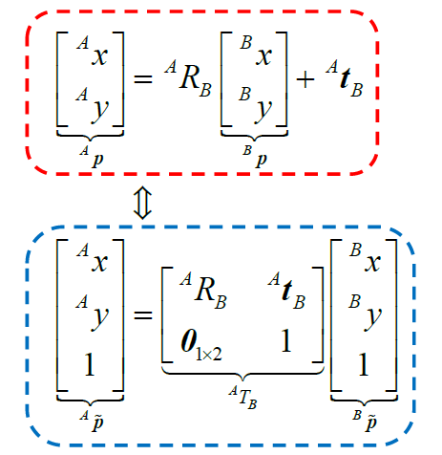
Investigating pose in 2D
We have “discovered” some basic constructions from projective geometry
Non-linear transformation of the Euclidean plane ℝ²
Linear transformation
of the projective plane Π²
Points in the Euclidean plane are described by Cartesian coordinates
Points in the projective plane are described by homogeneous coordinates
This means that they are only unique up to scale, i.e.
𝑥, 𝑦, 1 = 𝜆𝑥, 𝜆𝑦, 𝜆 ∀ 𝜆 ∈ ℝ\ 0
The matrix representing the projective transformation is also homogeneous, i.e.
^{𝐴}𝑇_{𝐵} = 𝜆^{𝐴}𝑇_{𝐵}∀ 𝜆 ∈ ℝ\ 0 ₃₇

Slide 17
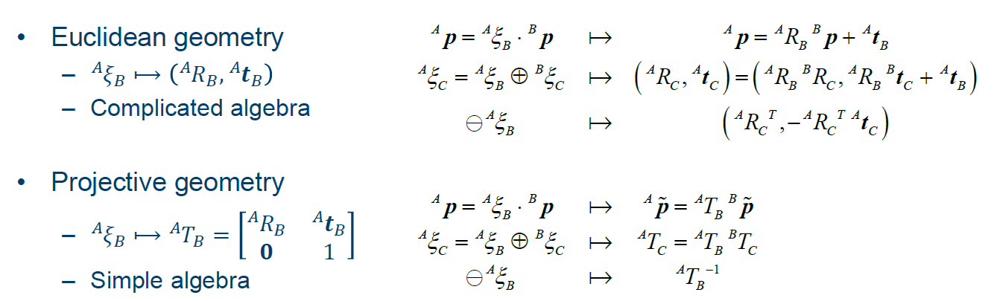
Investigating pose in 2D
Many problems in computer vision are easier to express and solve if we choose to think of points and transformations in terms of projective geometry
– Algebra and computations become simpler
Notes:
Matrix can be treated as a way of projection from one vector space to another

Slide 18
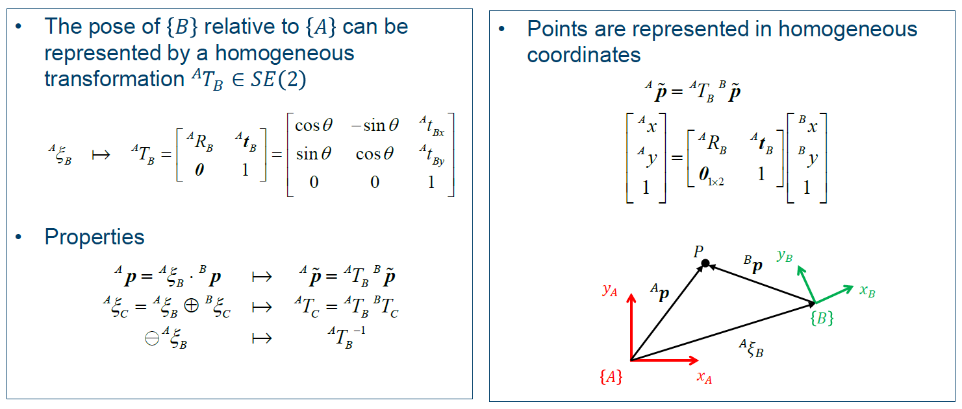
Representing pose in 2D

Slide 19
Example
𝑃
𝑦_{𝐵}
𝐵_{𝒑}
𝐴_{𝒑}
𝑥_{𝐵}
𝑦_{𝐴}
𝜃
𝐴_{𝒕𝐵}
𝑥_{𝐴}
Let ^{𝐴}𝒕_{𝐵} = 4,1 ^{𝑇}, ^{𝐵}𝒑 = 2,3 ^{𝑇} and 𝜃 = 27°
Determine the pose of of 𝐵 relative to 𝐴 , i.e. ^{𝐴}𝑇_{𝐵}
Determine the coordinates of 𝑃 in 𝐴 , i.e. ^{𝐴}𝒑

Slide 20
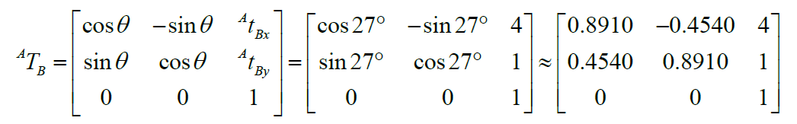
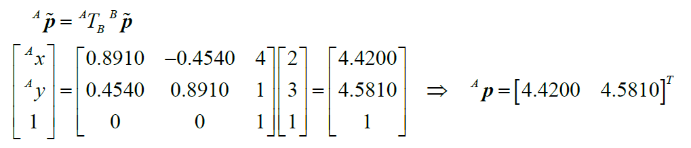
Example
From the previous slides we know that
This allows us to compute ^{𝐴}𝒑
This can also be verified by drawing

Slide 21


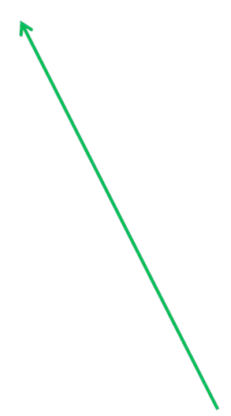

Example
𝑦
𝐴
4.5810
𝑃
4
𝑦_{𝐵}
3
3
𝑥_{𝐵}
2
2
27°
1
𝐴_{𝒕𝐵}
1
2
3
4 4.4200
𝑥_{𝐴}

Slide 22
General properties
𝑦_{𝐵}
𝑦_{𝐴}
𝑥_{𝐵}
𝐵
𝐴_{𝜉𝐵}
𝐴
𝑥_{𝐴}
Let us denote by ^{𝐴}𝜉_{𝐵} the pose of frame 𝐵 relative to frame 𝐴
We can think of ^{𝐴}𝜉_{𝐵} as the translation and rotation required in order to make with 𝐵
𝐴 coincide

Slide 23


General properties
𝑦_{𝐵}
𝑦_{𝐴}
𝑃
𝐵_{𝒑}
𝑥_{𝐵}
𝐴_{𝒑}
𝐵
𝐴_{𝜉𝐵}
Note that ^{𝐴}𝒑 and ^{𝐵}𝒑 are different vectors!!!
𝐴
𝑥
𝐴
A point 𝑃 can be described with respect to either frame
These descriptions are related by the pose
Formally we write this as ^{𝐴}𝒑 = ^{𝐴}𝜉_{𝐵} ∙ ^{𝐵}𝒑

Slide 24


General properties
𝑃
𝐵_{𝒑}
𝑦
𝐵
Action on points
^{𝐴}𝒑 = ^{𝐴}𝜉_{𝐵} ∙ ^{𝐵}𝒑
𝑦_{𝐴}
𝐴_{𝒑}
𝑥_{𝐵}
𝐵
𝐴_{𝜉𝐵}
Composition
𝐴
𝑥_{𝐴}
𝐴_{𝜉}
= ^{𝐴}𝜉_{𝐵}⨁^{𝐵}𝜉_{𝐶}
𝑦_{𝐵}
𝐶
𝑦
𝑥
𝑦_{𝐶}
𝐴
𝐴_{𝜉}
𝐵
𝐵_{𝜉𝐶}
𝐵
𝐵
𝐴_{𝜉}
𝐶
𝑥_{𝐶}
𝐴
𝑥_{𝐴}
𝐶
What about ^{𝐴}𝜉_{𝐵}⨁^{𝐵}𝜉_{𝐴}?

Slide 25

General properties
𝑃
𝐵_{𝒑}
𝑦
𝐵
Action on points
^{𝐴}𝒑 = ^{𝐴}𝜉_{𝐵} ∙ ^{𝐵}𝒑
Composition
^{𝐴}𝜉_{𝐶} = ^{𝐴}𝜉_{𝐵}⨁^{𝐵}𝜉_{𝐶}
Inverse
⊖ ^{𝐴}𝜉_{𝐵} = ^{𝐵}𝜉_{𝐴}
Neutral element
0 = ^{𝐴}𝜉_{𝐴}
0 ⊕ 𝜉 = 𝜉
𝜉 ⊖ 0 = 𝜉
𝜉 ⊖ 𝜉 = 0
⊖ 𝜉 ⊕ 𝜉 = 0
𝑦_{𝐴}
𝐴_{𝒑}
𝑥_{𝐵}
𝐵
𝐴_{𝜉𝐵}
𝐴
𝑥_{𝐴}
𝑦_{𝐵}
𝑦
𝑥
𝑦_{𝐶}
𝐴
𝐴_{𝜉}
𝐵
𝐵_{𝜉𝐶}
𝐵
𝐵
𝐴_{𝜉}
𝐶
𝑥_{𝐶}
𝐴
𝑥_{𝐴}
𝐶
𝑦_{𝐵}
𝑦
𝐴
𝑥
𝐵
⊖ ^{𝐴}𝜉_{𝐵}
𝐵
𝐴
𝑥_{𝐴}

Slide 26
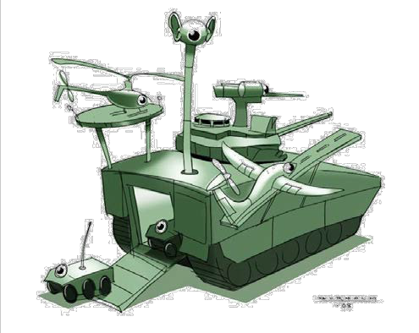
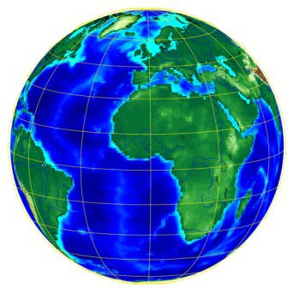


Example
Point observed by the camera
𝑃
Camera
𝐶
𝑊
𝑉
World
Vehicle

Slide 27

Example
Point observed by the camera
𝑃
𝐶_{𝒑}
Camera
𝐶
𝑉_{𝜉𝐶}
𝑊
𝑉
𝑊_{𝜉𝑉}
World
Vehicle

Slide 28



Example
Point observed by the camera
𝑃
^{𝑊}𝜉_{𝐶} = ^{𝑊}𝜉_{𝑉}⨁^{𝑉}𝜉_{𝐶}
𝐶
𝒑
Camera
𝐶
𝑊_{𝜉𝐶}
𝑉_{𝜉𝐶}
𝑊
𝑉
𝑊_{𝜉𝑉}
World
Vehicle

Slide 29



Example
Point with a known position relative to the camera
𝑃
^{𝑊}𝜉_{𝐶} = ^{𝑊}𝜉_{𝑉}⨁^{𝑉}𝜉_{𝐶}
𝐶
𝒑
Camera
𝑉_{𝒑}
^{𝑉}𝒑 = ^{𝑉}𝜉_{𝐶} ∙ ^{𝐶}𝒑
𝐶
𝑊_{𝜉𝐶}
𝑉_{𝜉𝐶}
𝑊
𝑉
𝑊_{𝜉𝑉}
World
Vehicle

Slide 30



Example
Point with a known position relative to the camera
𝑃
^{𝑊}𝜉_{𝐶} = ^{𝑊}𝜉_{𝑉}⨁^{𝑉}𝜉_{𝐶}
𝐶
𝒑
Camera
𝑉_{𝒑}
𝑊_{𝒑}
^{𝑉}𝒑 = ^{𝑉}𝜉_{𝐶} ∙ ^{𝐶}𝒑
𝐶
𝑊_{𝜉𝐶}
^{𝑊}𝒑 = ^{𝑊}𝜉_{𝑉}⨁^{𝑉}𝜉_{𝐶} ∙ ^{𝐶}𝒑
𝑉_{𝜉𝐶}
𝑊
𝑉
𝑊_{𝜉𝑉}
World
Vehicle

Slide 31
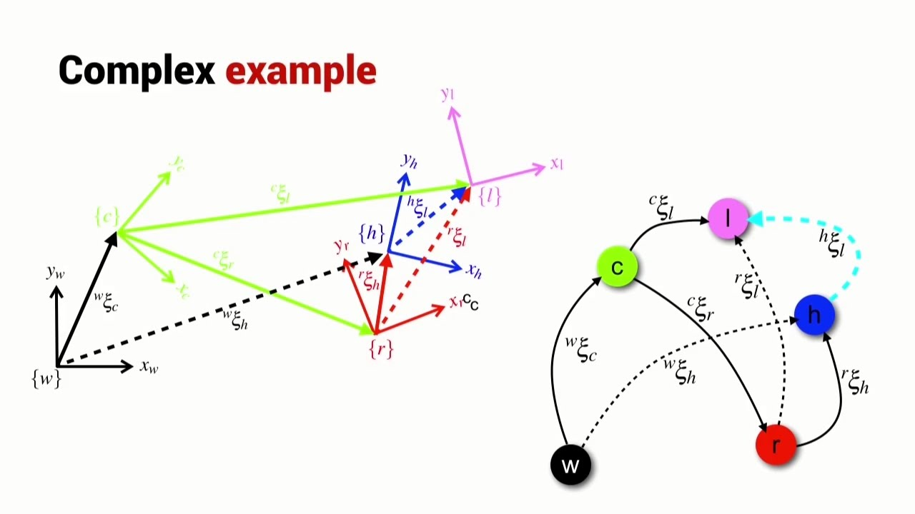
Pose Graph

Slide 32
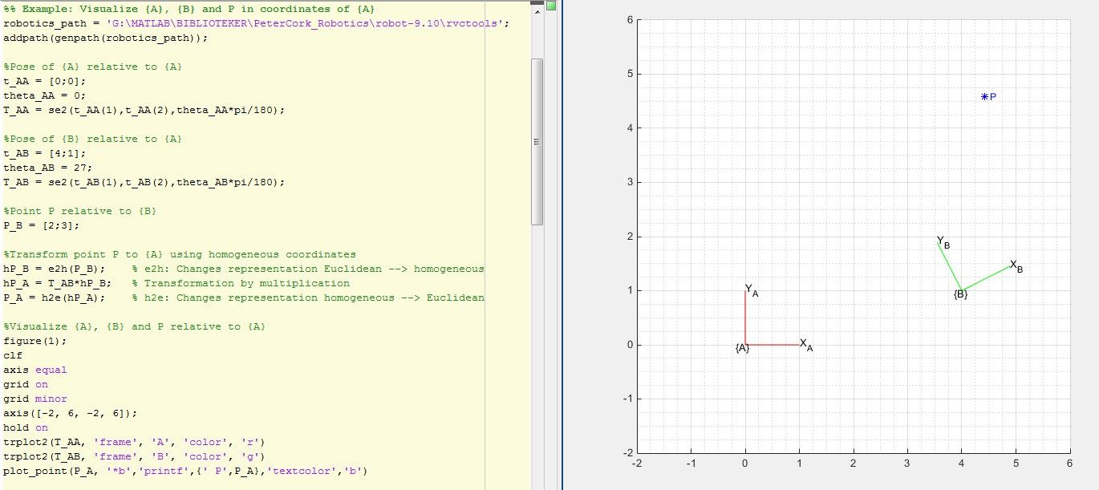
Example

Slide 33
Representing 3D Orientations with Rotation Matrices
3D rotations around the origin of R³ form the rotation group.
3D rotations can be uniquely parametrized by special orthogonal matrices (rotation matrices).
Compounding still holds: ^{C} R_{A} = ^{C} R_{B}^{B} R_{A}.
Rows of a rotation matrix give the directions of the new frame’s axes relative to the current frame.
More parameters than degrees of freedom.
The rotation group is often referred to as the special orthogonal group
SO(3).

Slide 34
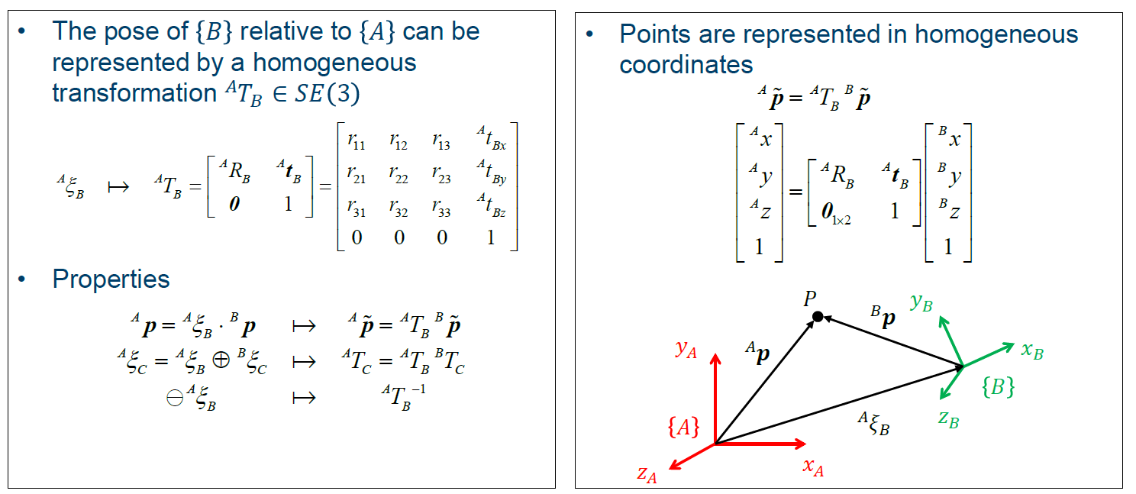
Representing pose in 3D

Slide 35
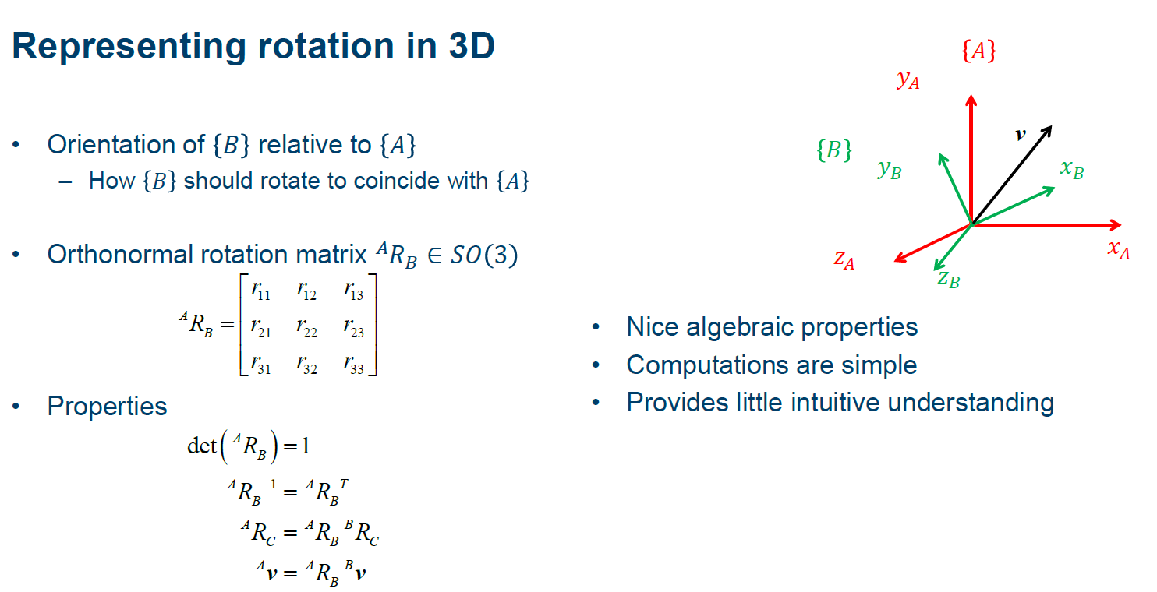

Slide 36
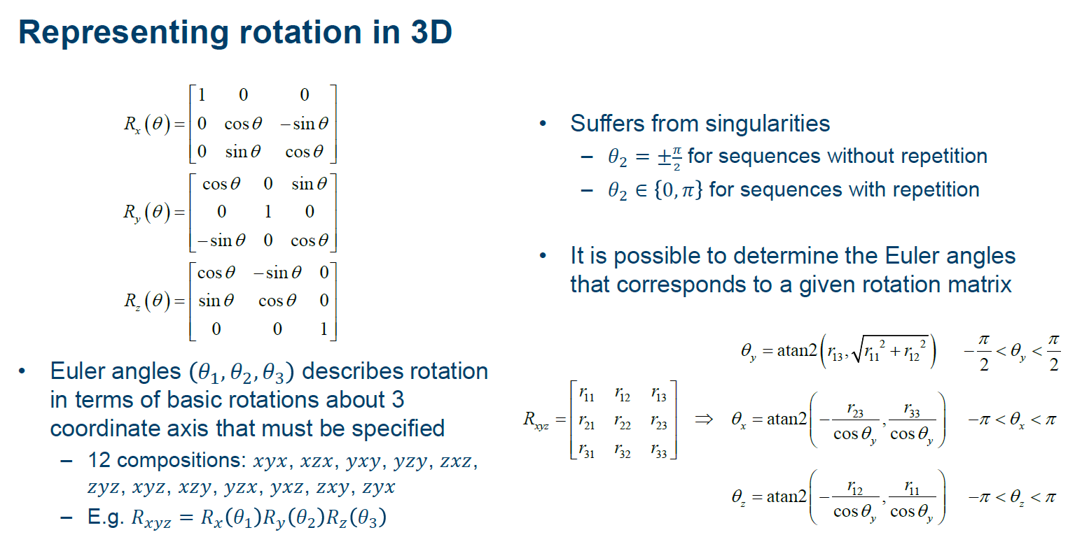

Slide 37



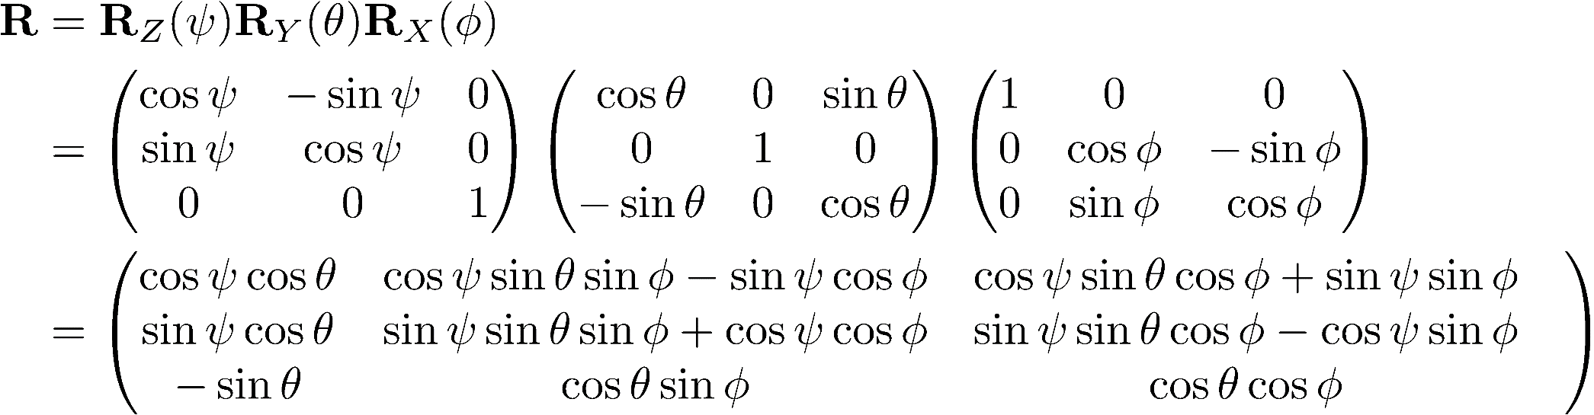
Roll-Pitch-Yaw Convention
Roll , Pitch , Yaw
Conversion to 3x3 rotation matrix:
Notes:
Rotate along x first, then y and z
Try MATLAB Code:
R = rotz(0.1) * roty(0.2) * rotz(0.3);
R = eul2r(0.1, 0.2, 0.3)
gamma = tr2eul(R)
R = eul2r(0.1 , -0.2, 0.3)
tr2eul(R)
eul2r(ans)
R = eul2r(0.1, 0, 0.3)
tr2eul(R)

Slide 38
Representing 3D Orientations with Three Angles
z, z'
Given three angles (α, β, γ), let a-b -c denote the application of
y'''
a rotation of α around axis a,
a rotation of β around axis b , b is b rotated by α around a
and a rotation of γ around axis c (in that order), c is c rotated by α around a, then by β around b
z'', z'''
β
y
x'''
α
γ
x
x', x''
Three angles (α, β, γ), 12 representations of a 3D rotation:
Euler angles: z-x -z , x-y -x , y-z -y , z-y -z , x-z -x , y-x -y .
Tait–Bryan angles: x-y -z , y-z -x , z-x -y , x-z -y , z-y -x , y-x -z .
This is called the three-angle representation with intrinsic rotations.
Notes:
Note: Intrinsic vs Extrinsic Rotations
Intrinsic rotations apply to axis in rotated coordinate system
Coordinate system of next rotation relative to previous rotation
Extrinsic rotations apply to axis in world coordinate system
Coordinate system of next rotation relative to (fixed) world coordinate system

Slide 39
Representing 3D Orientations with Three Angles
Three-angle representation with extrinsic rotations
Given three angles (α, β, γ), let a-b-c denote the application of
a rotation of α around axis a,
a rotation of β around axis b,
and a rotation of γ around axis c (in that order).
Three angles (α, β, γ), another 12 representations of a 3D rotation:
Euler angles: z-x-z, x-y-x, y-z-y, z-y-z, x-z-x, y-x-y.
Tait–Bryan angles: x-y-z, y-z-x, z-x-y, x-z-y, z-y-x, y-x-z.
This is called the three-angle representation with extrinsic rotations.

Slide 40
Visualizing Intrinsic Three-angles
Example: Given three angles (α, β, γ), z-x -z denotes the application of
a rotation of α around axis z,
a rotation of β around axis x , x is x rotated by α around z
and a rotation of γ around axis z (in that order),
z is z rotated by α around z, then by β around x
z, z'
y'''
z'', z'''
β
y
x'''
α
γ
x
x', x''

Slide 41
Three-angles: Matrix Equivalents
Intrinsic rotations equivalent with rotation matrices:
x-y -z : R_{x}(α)R_{y} (β)R_{z} (γ)
z-x -z : R_{z} (α)R_{x}(β)R_{z} (γ)
Compare with:
Extrinsic rotations equivalent with rotation matrices:
x-y-z: R_{z} (γ)R_{y} (β)R_{x}(α)
z-x-z: R_{z} (γ)R_{x}(β)R_{z} (α)

Slide 42
There Are 24 Three-angles Representations
Extrinsic Euler: z-x-z, x-y-x, y-z-y, z-y-z, x-z-x, y-x-y.
Intrinsic Euler: z-x^{I}-z^{II}, x-y^{I}-x^{II}, y-z^{I}-y^{II}, z-y^{I}-z^{II}, x-z^{I}-x^{II}, y-x^{I}-y^{II}. Extrinsic Tait-Bryan: x-y-z, y-z-x, z-x-y, x-z-y, z-y-x, y-x-z.
Intrinsic Tait-Bryan: x-y^{I}-z^{II}, y-z^{I}-x^{II}, z-x^{I}-y^{II}, x-z^{I}-y^{II}, z-y^{I}-x^{II}, y-x^{I}-z^{II}.
When you read a book, or code documentations, you almost never know if the author is using intrinsic or extrinsic ( and are omitted). The Corke book doesn’t say it’s using intrinsic rotations.
Often, you will not know which of the Euler or TB representation the author is using.
With TB representations, some authors give the three angles in inverse order (i.e., in the order of the rotation matrix form).
All of the above are the first reason why three-angles are horrible.

Slide 43
Why Three-angles Are Horrible
24 representations, plus different names (TB also called yaw-pitch-roll, TB sometimes referred to as Euler).
Singularities: Assuming Euler z-y -z ,
(α, 0, γ) ∼ (α + c, 0, γ − c)∀c ∈ R
Numerical instability.
Three-angle representations are horrible. You should avoid using them.
However, you will come across them outside of this class. Thus you must know how to read them.

Slide 44
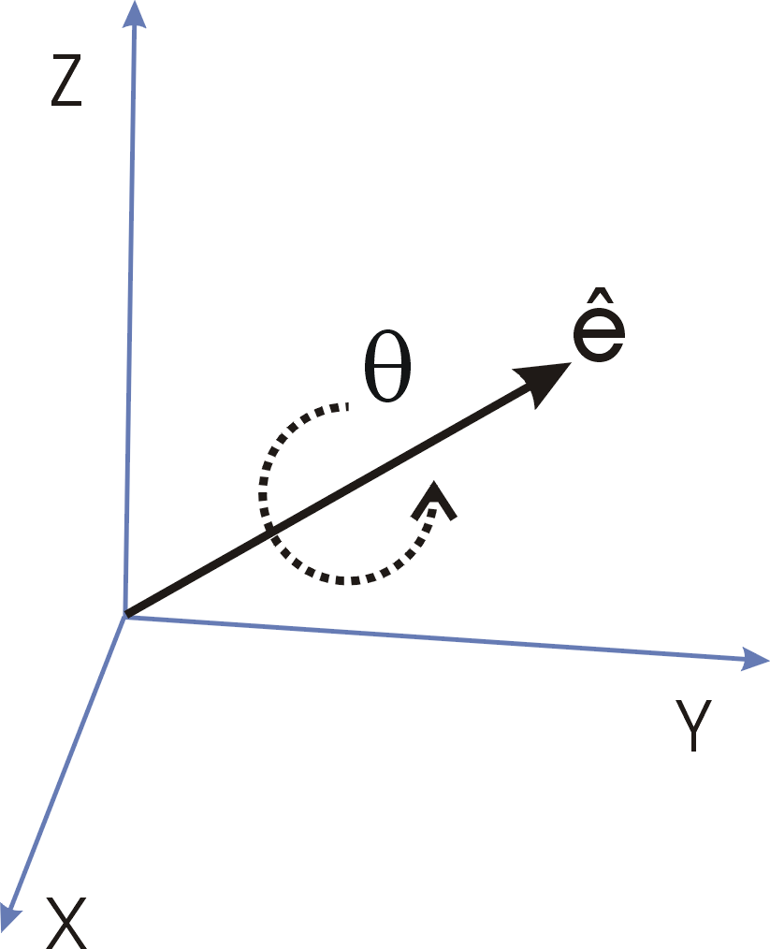
Representing Rotations with Axis-angles
Any 3D rotation can be expressed as a rotation of θ around an axis v.
This is an intuitive representation, but compositions are not as easy as with rotation matrices.

Slide 45
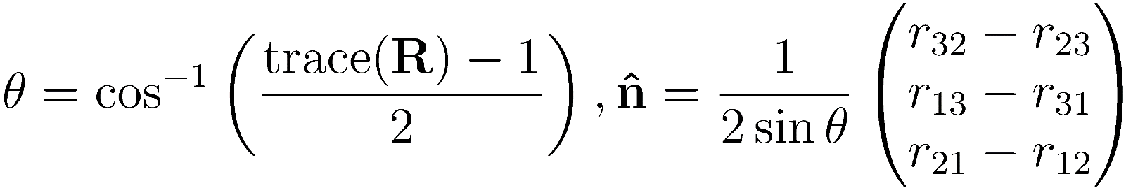
Conversion
Rodriguez’ formula
Inverse

Slide 46
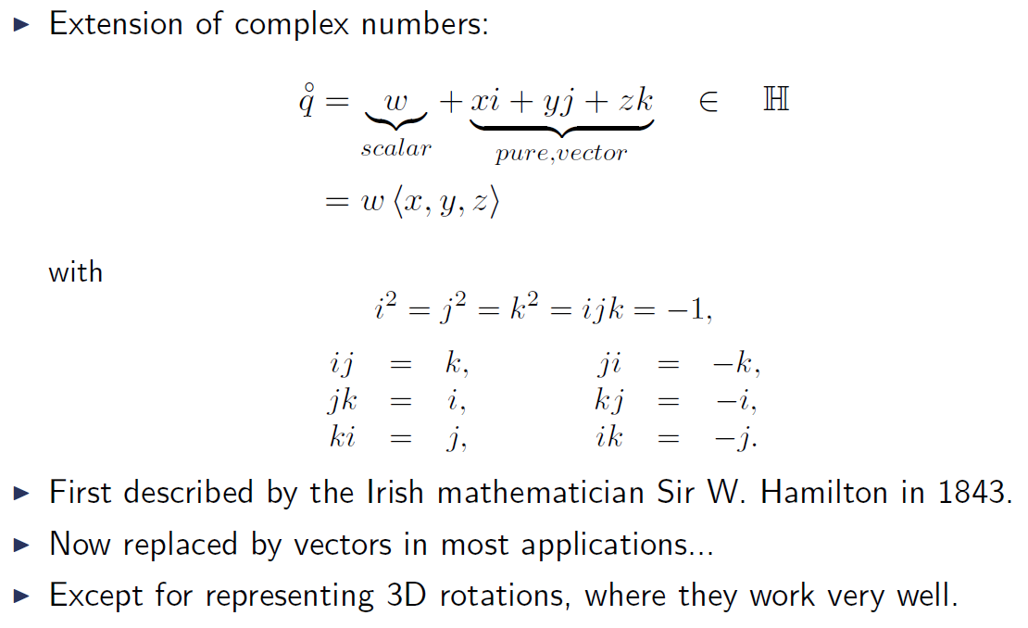
Quaternions: History & Definition

Slide 47
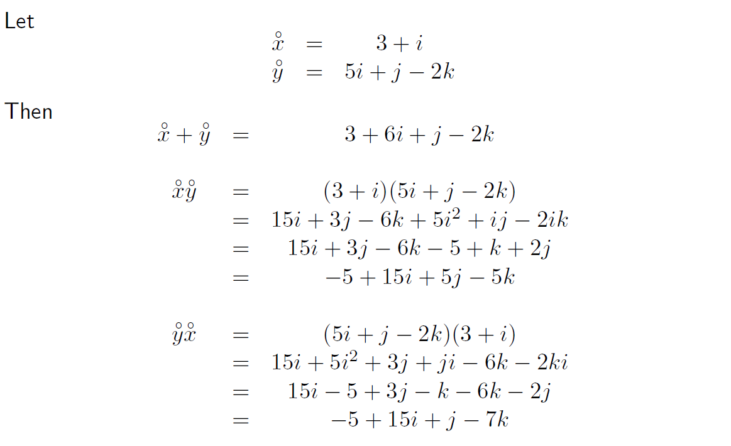
Quaternion Arithmetic: Sum, Product

Slide 48
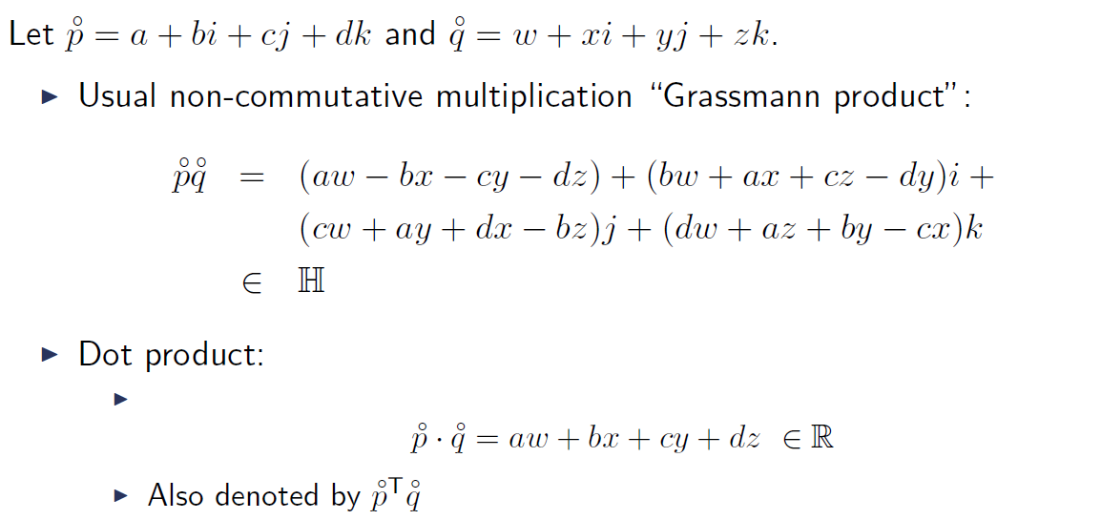
Quaternion Arithmetic: Product

Slide 49
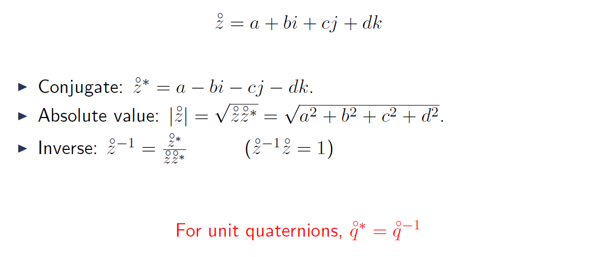
Quaternion Arithmetic: Conjugate, Absolute value, Inverse

Slide 50
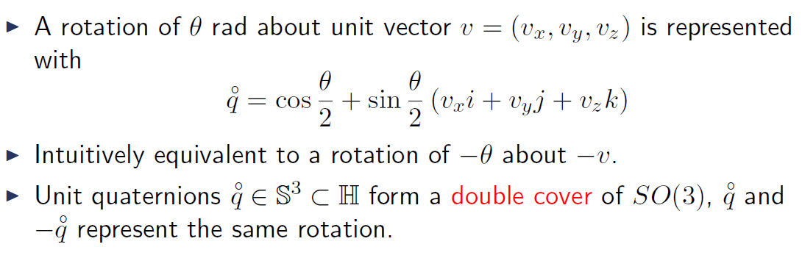
Representing 3D Rotations with Unit Quaternions

Slide 51
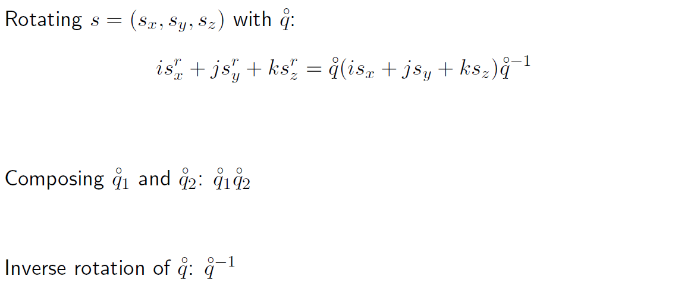
Unit quaternions for a 3D rotation

Slide 52
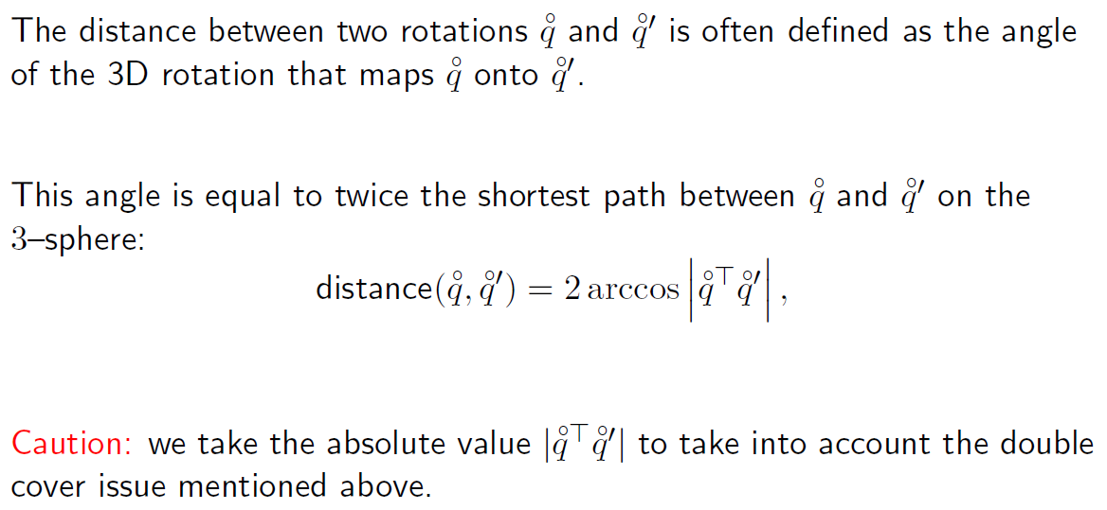
Distance Between Two Rotations

Slide 53
Benefits of Unit Quaternions for Representing 3D Rotations
Not even speaking about three-angles. Axis-angles are awkward to compose.
Compared to rotation matrices:
Compact representation;
More efficient for composition;
Intuitive metric;
Smooth interpolation;
Robustness to numerical drift

Slide 54
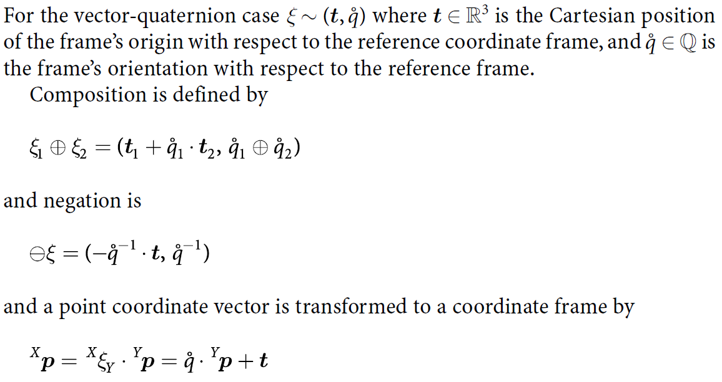
Representing 3D transformation/poses with 3-vectors and Quaternions

Slide 55
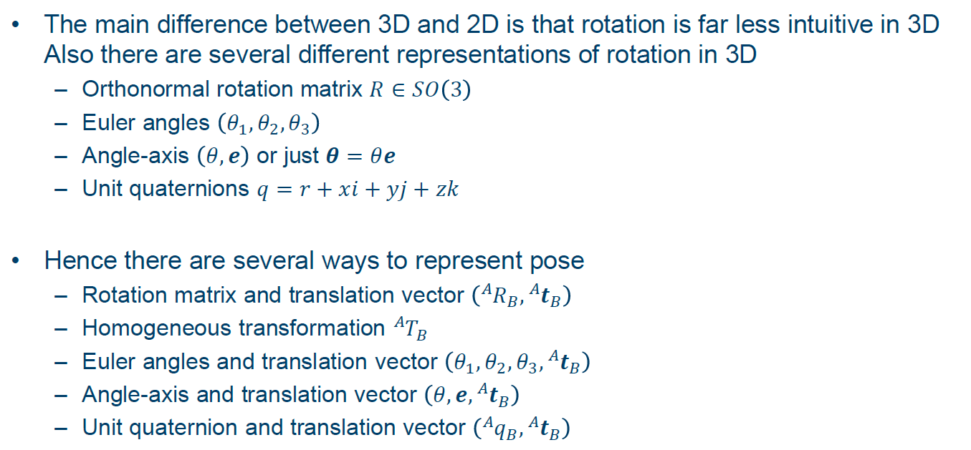
Representing pose in 3D

